Slide 1
Foundations of CS & AI
Zhao Fengnian
School of Computer Science

Slide 3
Lexue online classroom
CS class: https://lexue.bit.edu.cn/course/view.php?id=15762
Economics class: https://lexue.bit.edu.cn/course/view.php?id=15764

Slide 4

Who am I?
赵丰年（Randy）
zhaofn@bit.edu.cn
13521010011

Slide 5




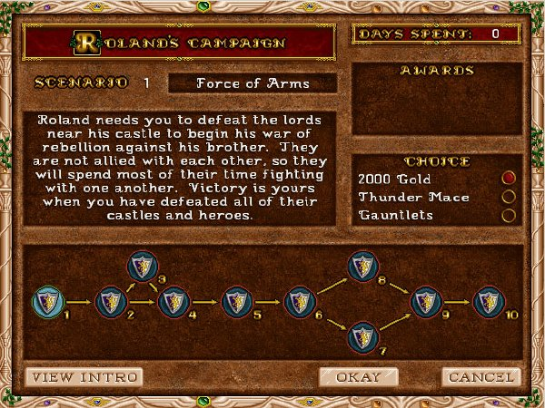


Slide 6
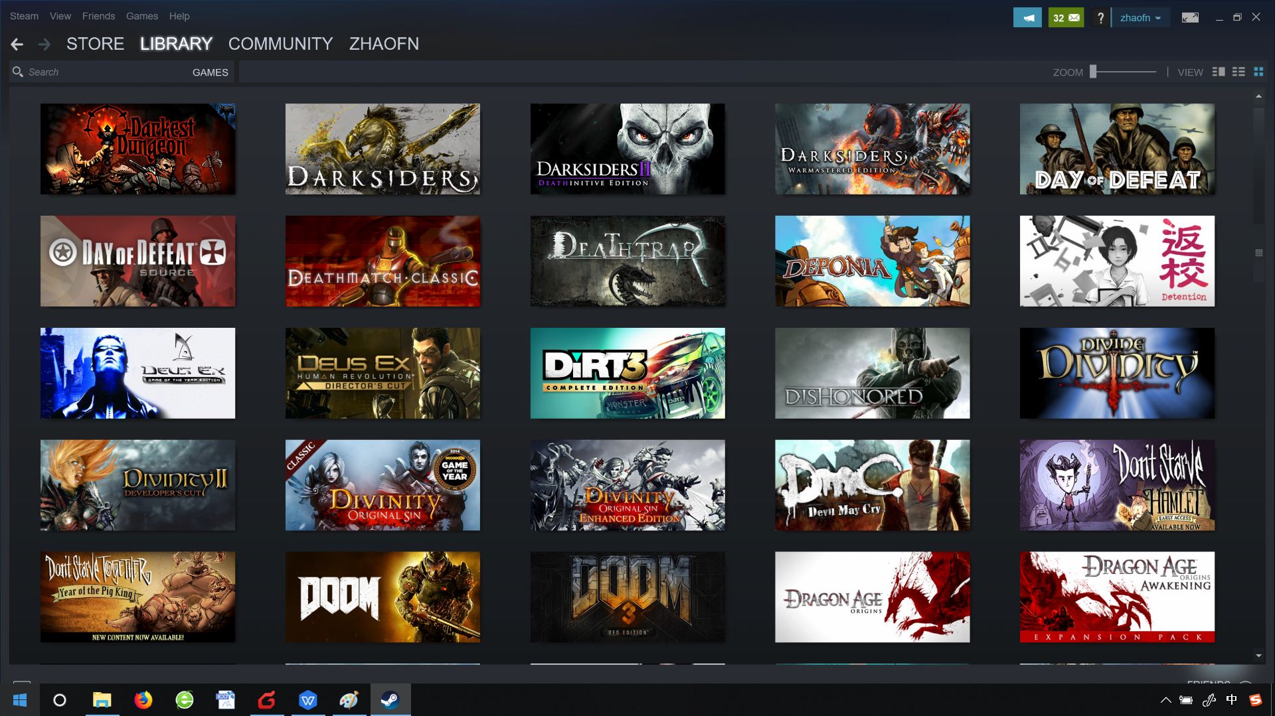

Slide 7
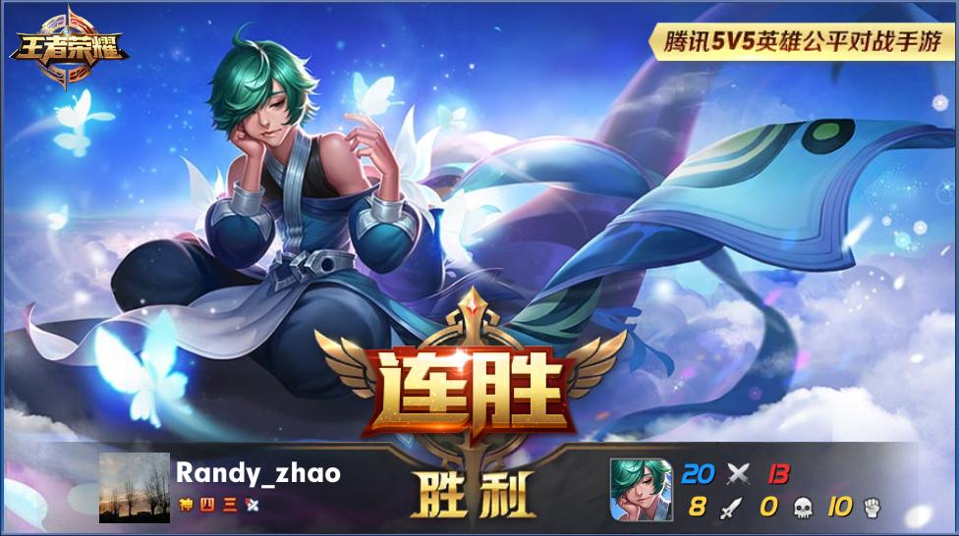
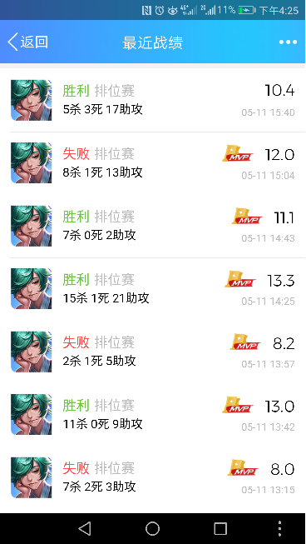
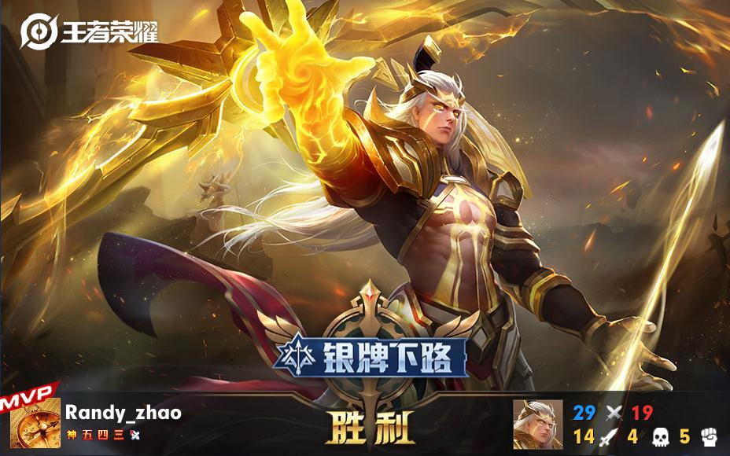

Slide 9
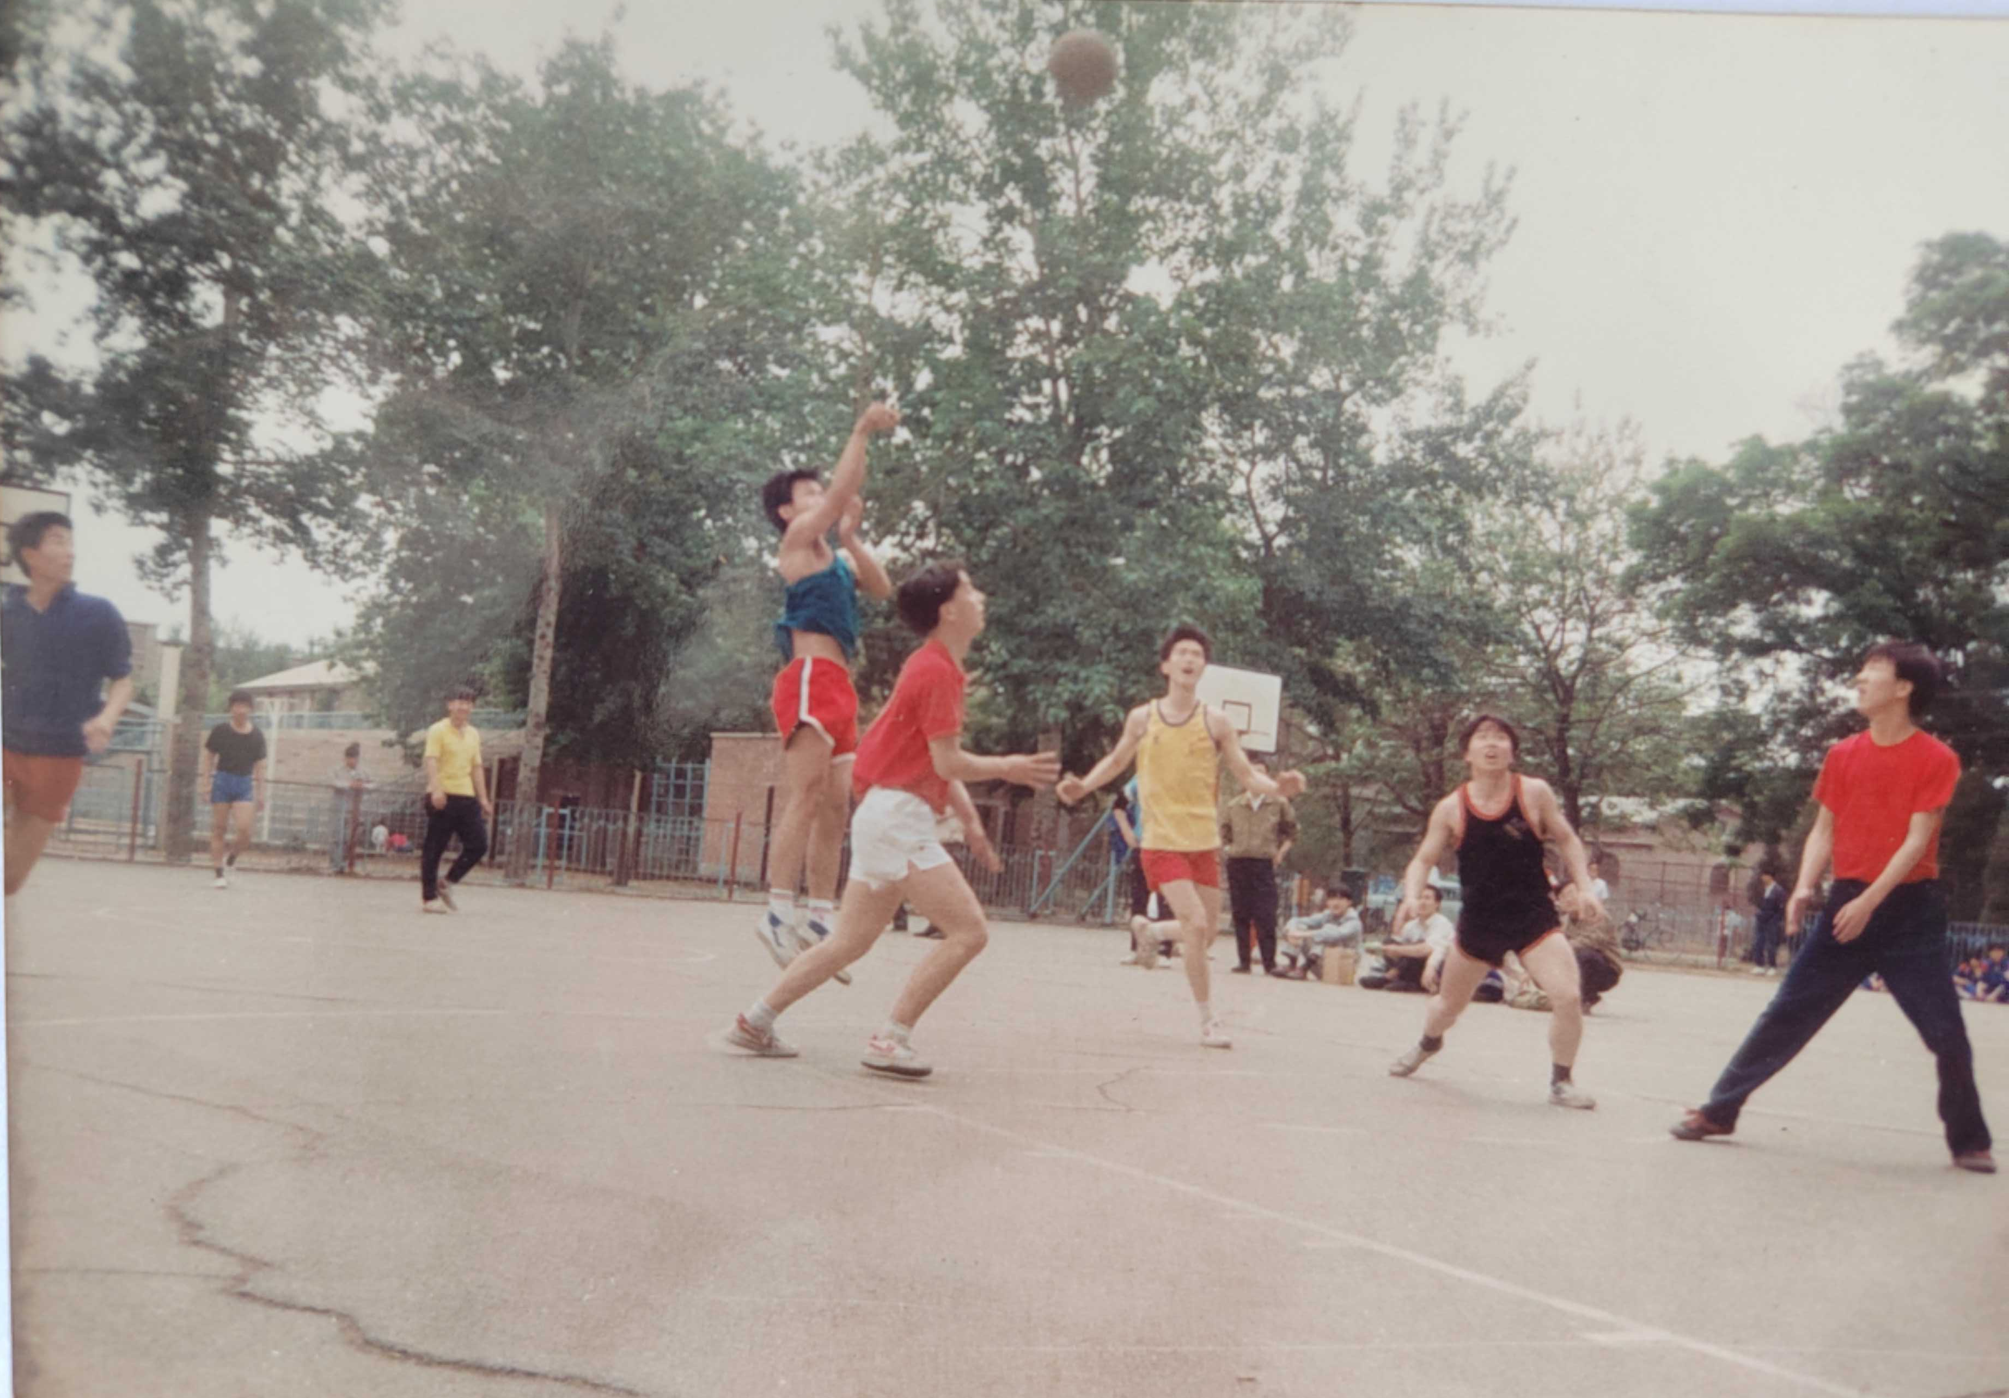

Slide 11
Who are you？
background (hometown, interests, etc.)
understanding of CS and AI
expectations of the course

Slide 12

Learning objectives
Get used to the basics of CS
Get used to the basics of AI
Become a problem solver

Slide 13
Textbook（本命ほんめい）

Slide 14
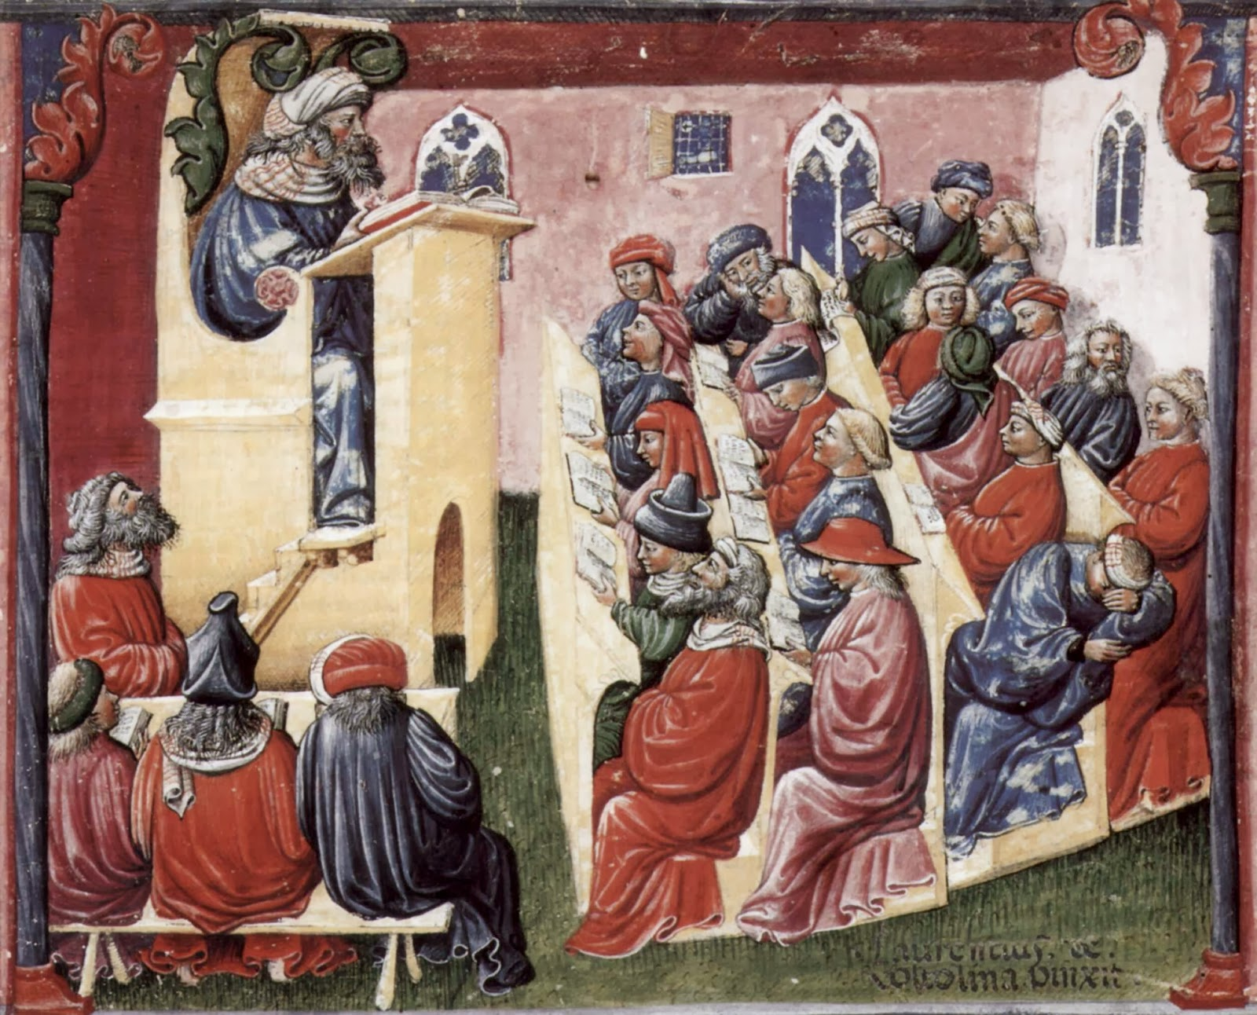
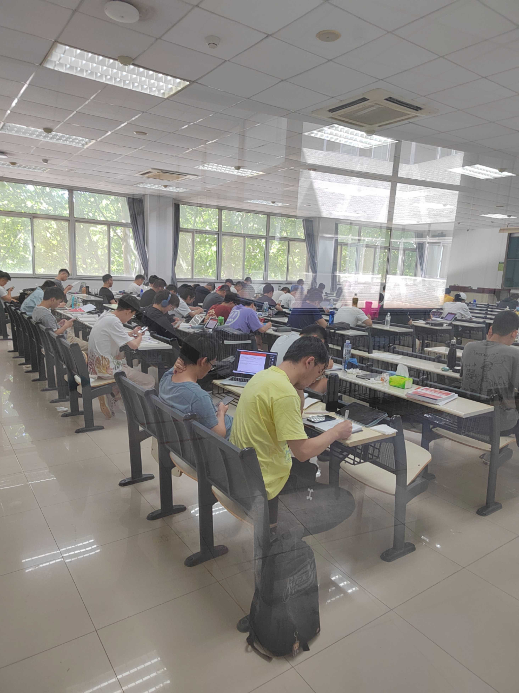

Slide 15
Resources
乐学(lexue)
Internet (online courses such as CS50), wikipedia, chatGPT, social networks, Wechat/QQ, blogs, etc.)
Fellow students
Library
Teacher

Slide 16
Q & A
What to learn?
Subject matter
English
“soft” skills
How to learn
Come to class
Self/team study
Learning by teaching/making/doing

Slide 17
All learning is...
Language as a Tool for Thought
Language as a Medium of Instruction
Language Shapes Perception and Experience
Learning New Vocabulary and Concepts
Language and Social Learning
Metalinguistic Awareness

Slide 18
Pretest

Slide 19
Course Overview
Introduction to CS and AI
Hardware + Networks
Software + Algorithms + Data Structures
Symbolic AI
Connectionist AI
Behavioral AI

Slide 20
Student Evaluation
class project (50%)
final exam (50%)

Slide 21
Class Project
teams of 5 ~ 6
Key deliverables

Slide 22
Key Deliverables
PPT slides & Video tutorials
Word/PDF Study Guide
a)Learning suggestions
b)Subject matter details
c)Learning material list
d)Case studies
e)Exercises
f)Tests
g)Other stuff (such as mindmaps, videos, etc.)
Lexue Learning System (interactive study guide）

Slide 23
Modules
AI Overview
Hardware & Behavorial AI (inc.Networks)
Software & Symbolic AI
Algorithms & Connectionist AI (inc. DSs)
Big Data & Connectionist AI

Slide 24
Team up
Roles：CEO、CTO、CIO（submit assignment）、Designer、Writer、QA(tester)
Rules：
male >=1 && female >=1
number of people = 5~6
computer literacy、literacy vs test-oriented、introvert vs extrovert average score ≈ 3
Diversified skills
Tank
DPS
Healer
Doubi

Slide 25
Evaluation
Project(50%)
team score
personal contribution score (weight)
Final(50%)
closed book Lexue/online test
most test items are from the materials you created
20% True/False, 20% Multiple Choice,60% Problem Solving & Open-ended Questions

Slide 26
Checklist (what to do after class?)
 Get a textbook
 Get used to what class of 2023 did
 Get used to the landscapes of Lexue
 ?
 ?

Slide 27
Let’s get started…...

